Slide 1

Nowruz is the celebration of the Persian New Year. Persia is the old name for Iran. Just like we begin a new year on the 1st day of January, Iranians begin the New Year, on the first day of Spring, at the exact time it begins. This year Spring begins on the 20th of March at 03:33:26 pm. Nowruz is a holiday in Iran and many countries around the world.

Slide 2
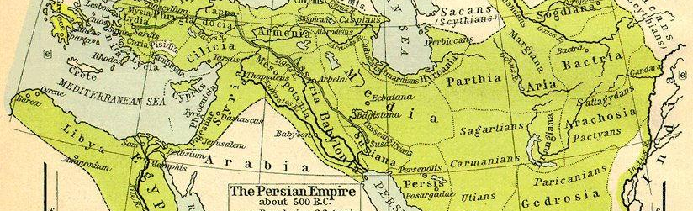
Iranians began celebrating Nowruz around 3 thousand years ago in Persia, which at the time stretched from the river Nile in the west to India in the east. Now Nowruz is celebrated by Iranians and millions of people around the world.

Slide 3
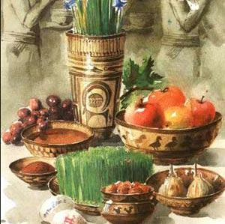
Families set a Nowruz table called Haft-Seen. A colourfull table includes seven natural organic items whose names begin with the letter S, which is ‘seen’ in Farsi or Iranian language. ‘Seen’ symbolizes a yearning, something you wish. In Farsi this is called Haft-Seen, which means seven S’s.

Slide 4
Seeb means apple. This is symbol of health.
Serkeh means vinegar. This is symbol of wisdom and patience
Seer means garlic which symbolizes medicine.

Slide 5
Somaq is a spice which symbolizes sunrise and sunshine.
Sabzeh are grown lentil and wheat shoots symbolizing good harvest.
Sekeh means gold coin symbolizing wealth.
Senjed is a dried fruit which symbolizes love.

Slide 6
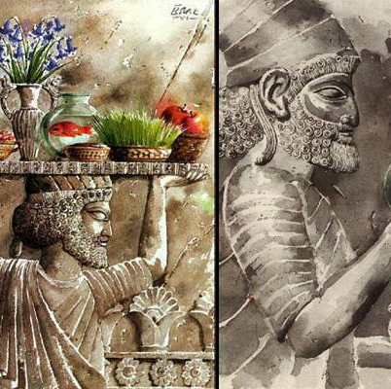
Here are also other items on the Haft- Seen table that don’t begin with letter S but have a special meaning. For example Gold fish is a symbol of water and life. Mirror is symbol of sky and reflection. Colored eggs are symbol of new life and fertility, and Candles are symbol of fire.

Slide 7
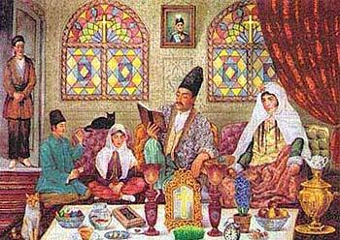
Before the new year starts, families get around the Haft-Seen table and count down to the new year. They then hug and wish each other a good new year and eat sweets. They spend the rest of the day visiting family and friends, beginning with the elders, who give the younger family members freshly minted money notes.

Slide 8
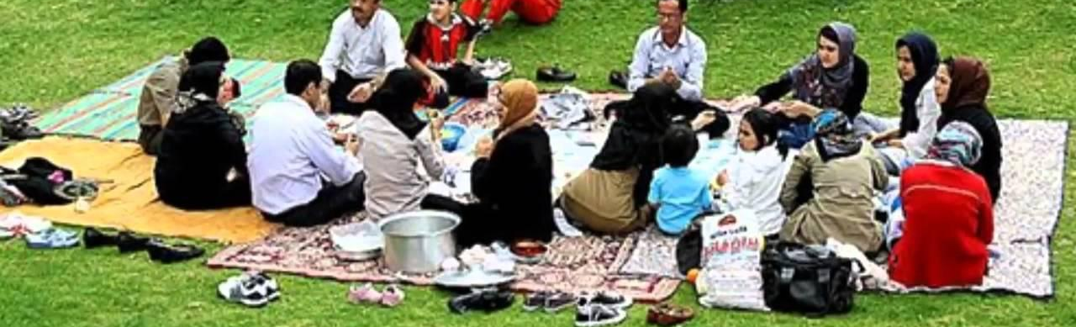
The final day of Nowruz is called sizdahbedar. This is the 13th day of Farvardin, which is first month of the new year. Sizdah means 13 in Farsi which is considered an unlucky number. People aim to spend this day outside their homes. Families go on a picnic outdoor in the orchards, by the lakes or rivers. They eat and drink, play games and sing songs and dance. Sizdahbedar is the last day of Nowruz holidays. On the14th day of the new year children go back to school and share their happy memories and experiences with their peers.

